Slide 1
Credit EDA Case Study
By: Veerabhadra Rao Kola
DSC 37 Batch

Slide 2
Exploratory Data Analysis Case Study :
Problem Statement :
This contextual analysis means to provide you with a thought of applying EDA in a genuine business situation. For this situation study, aside from applying the strategies that you have learnt in the EDA module, you will likewise foster a fundamental comprehension of hazard examination in banking and monetary administrations and see how information is utilized to limit the danger of losing cash while loaning to clients.
Business Understanding :
The loan providing companies find it hard to give loans to the people due to their insufficient or non-existent credit history. Because of that, some consumers use it as their advantage by becoming a defaulter. Suppose you work for a consumer finance company which specializes in lending various types of loans to urban customers. You have to use EDA to analyze the patterns present in the data. This will ensure that the applicants capable of repaying the loan are not rejected.

Slide 3
When the company receives a loan application, the company has to decide for loan approval based on the applicant’s profile. Two types of risks are associated with the bank’s decision:
If the applicant is likely to repay the loan, then not approving the loan results in a loss of business to the company
If the applicant is not likely to repay the loan, i.e. he/she is likely to default, then approving the loan may lead to a financial loss for the company.
The data given below contains the information about the loan application at the time of applying for the loan. It contains two types of scenarios:
The client with payment difficulties: he/she had late payment more than X days on at least one of the first Y instalments of the loan in our sample,
All other cases: All other cases when the payment is paid on time.
When a client applies for a loan, there are four types of decisions that could be taken by the client/company):
Approved: The Company has approved loan Application
Cancelled: The client cancelled the application sometime during approval. Either the client changed her/his mind about the loan or in some cases due to a higher risk of the client he received worse pricing which he did not want.
Refused: The company had rejected the loan (because the client does not meet their requirements etc.).
Unused offer: Loan has been cancelled by the client but on different stages of the process.
In this case study, you will use EDA to understand how consumer attributes and loan attributes influence the tendency of default.

Slide 4
Hazardous Applicants:
Following are the sorts of candidates with high danger factor implied:
Those who have been in the workforce for less than three years.
On average, Men with a lower secondary education, in their thirties, earning less than one lakh, and living in a rented apartment
Those who have a region rating of 3 and a score of less than 0.5
Unemployed people Pensioners under the age of 30 are more likely to face payment difficulties.
Lower secondary education-Civil Marriage & Singles, People who live in rented apartments
The age group 30 living in rented apartments has a higher risk of exhibiting monetary difficulty
Low-skilled workers,
Male real estate agents
Female waitresses and bartenders

Slide 5
Case Study Summary:
Defaulters demography:
All the beneath factors were set up in examination of Application data frame as prompting default. Checked these against the Approved advances which have defaults, and it ends up being right -Medium pay -25-35 years olds , followed by 35-45 years age bunch -Male -Jobless -Workers, Salesman, Drivers -Business type 3 -Own House - No Other IMPORTANT Factors to be thought of -Days last telephone number changed - Lower figure focuses at concern -No of Bureau Hits in the week before. Month and so forth – zero hits is great -Sum pay not correspondingly comparable to Good Bought – Income low and great worth high is a worry -Past applications with Refused, Cancelled, Unused credits likewise have default which involves concern. This shows that the monetary organization had Refused/Cancelled past application however has endorsed the current and is confronting default on these.
Dependable Applications declined:
Unused applications have lower advance sum. Is this the justification behind no use? -Female candidates ought to be given extra weightage as defaults are lesser. -60% of defaulters are Working candidates. This doesn't mean working candidates should be declined. Appropriate investigation of different boundaries required -Past applications with Refused, Cancelled, Unused advances additionally have situations where installments are coming on schedule in current application. This demonstrates that potentially off-base choices were done in those cases.

Slide 6
Customers with the higher rejection ratio and default in the current application (on the lower bottom of graph 1(age group -20 -50 ) are with high risk profiles hence could be rejected the loans if their external credit score is less and income levels are relatively low and credit amount applied is high,
More than 25% people who have made no default in the current loan have a lower rejection ratio(higher approval ratio, >.75) across all age groups, They are low risk customers who could be given higher credit loans in future applications. One thing to be mindful here is the number of approved loans a particular customer holding till date,
Customers who had a higher approval ratio but defaulted with the current application could be granted with loans with lesser credit amount since a higher credit amount would attract higher interest charges and that would further stress the customer financially.
Males exhibited more payment difficulty although there were more female applicants,
Low skilled labors are more likely to payment default,
As expected unemployed and lower income group exhibited higher payment default tendency.
As the employment years of a person is more he is less likely to make
default,

Slide 7
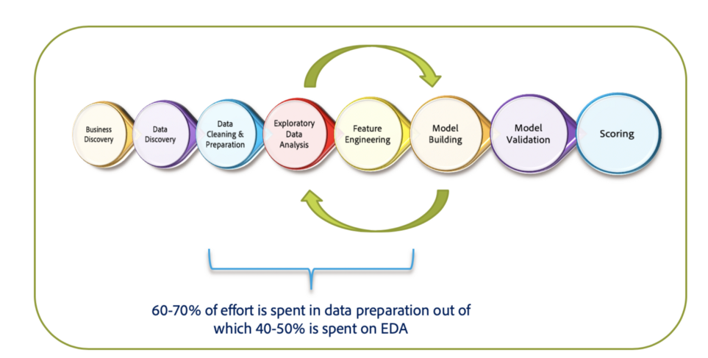
Steps involved in EDA:
Data sourcing and comprehension.
Inspect for issues with data quality and binning.
Examine the data for imbalance and univariate, segmented univariate and bivariate analysis, as well as correlation.
Application data merging with previous application data.
Data analysis using univariate, segmented univariate, and bivariate analysis, as well as correlation.
Suggestions and Risks

Slide 8
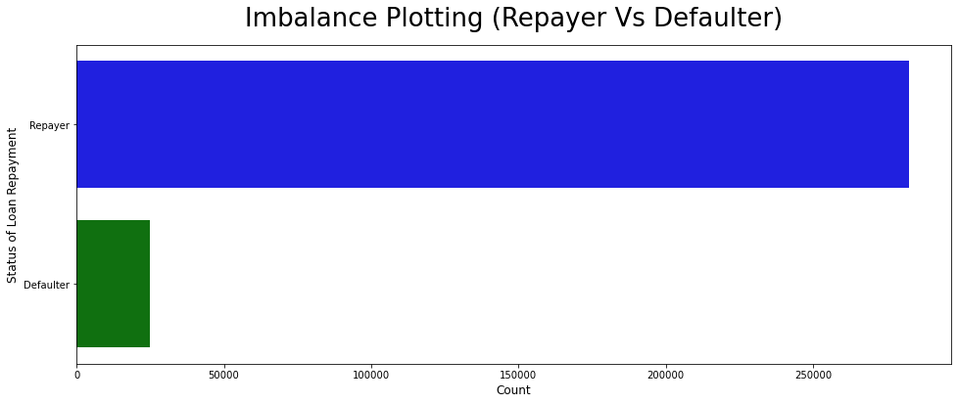
The percentage of the imbalance in relation to the defaulter and the repayer.
The repayment rate is 91.93 percent.
The defaulter rate is 8.07 percent.
Imbalance The ratio between the repayer and the defaulter is 11.39/1. (approx.)

Slide 9
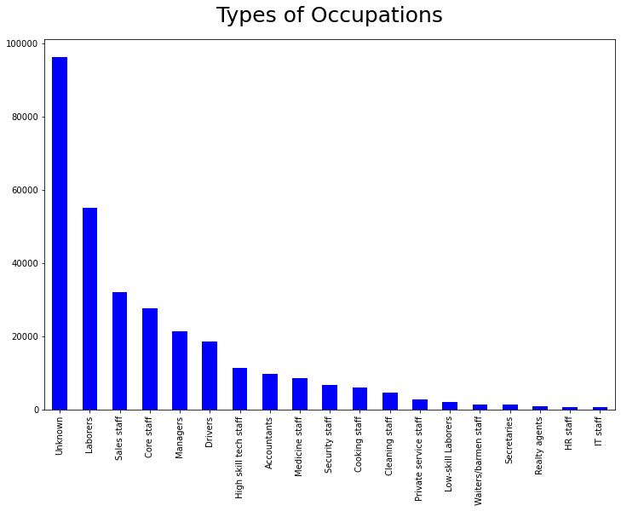
The unknown group has the highest percentage of values, followed by labourers.

Slide 10
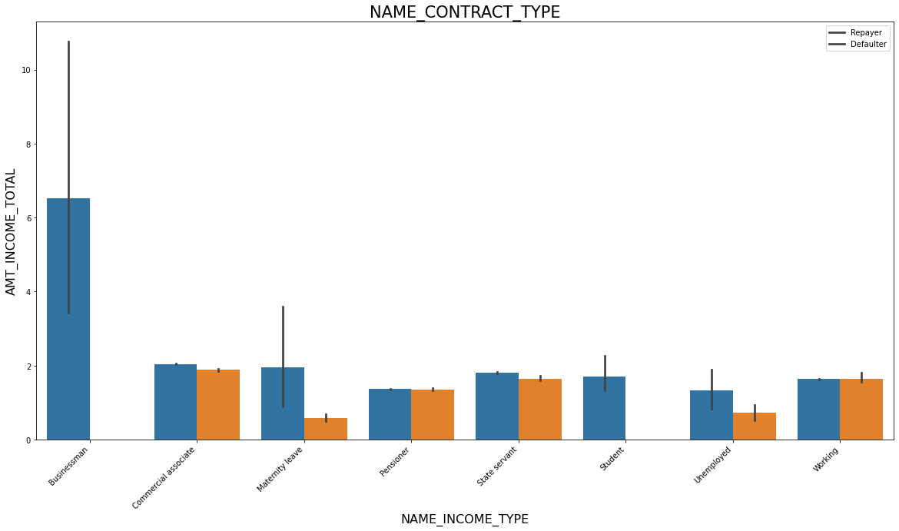
Based on loan repayment status, the contract type is determined.

Slide 11
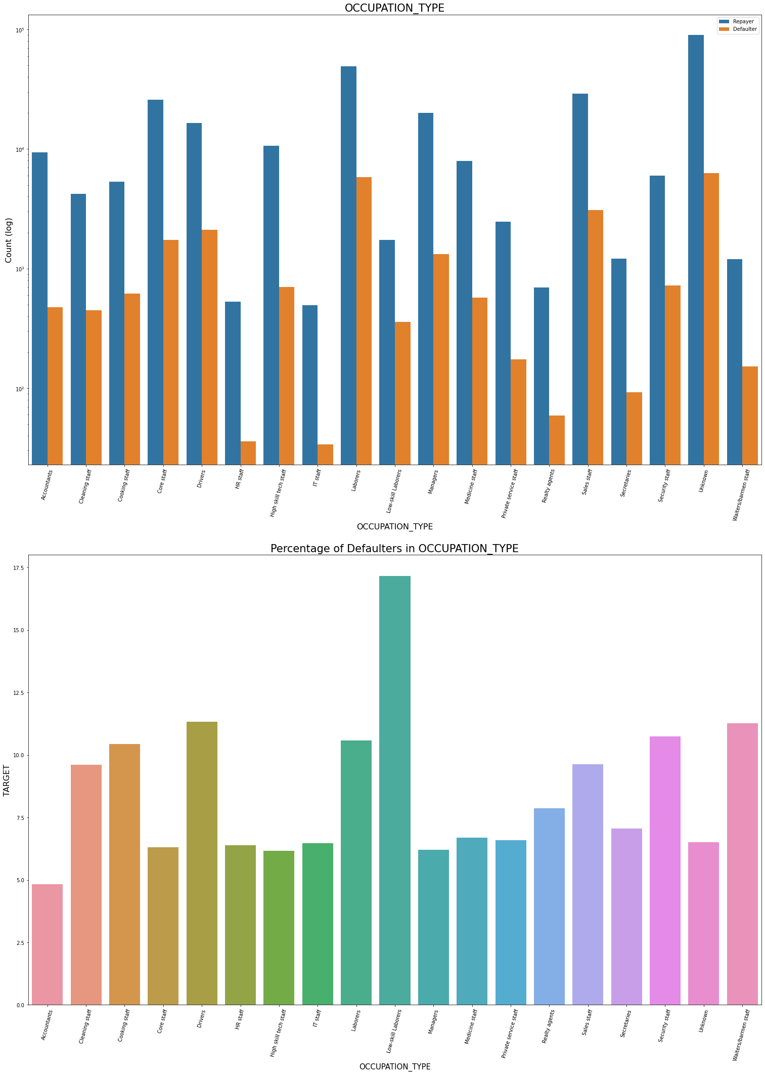
Categorical Univariate Analysis:

Slide 12
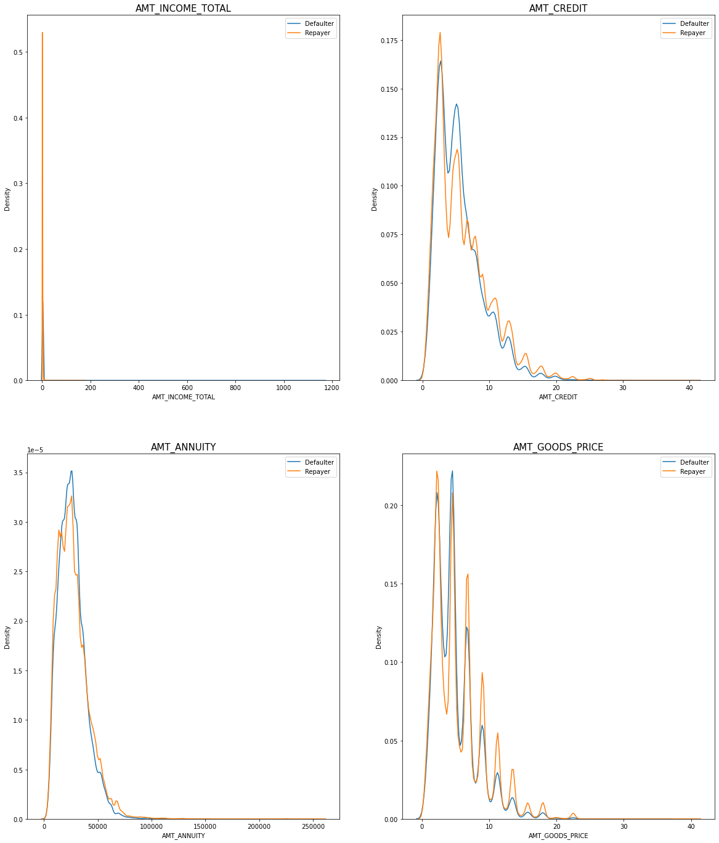
Numerical Univariate Analysis

Slide 13
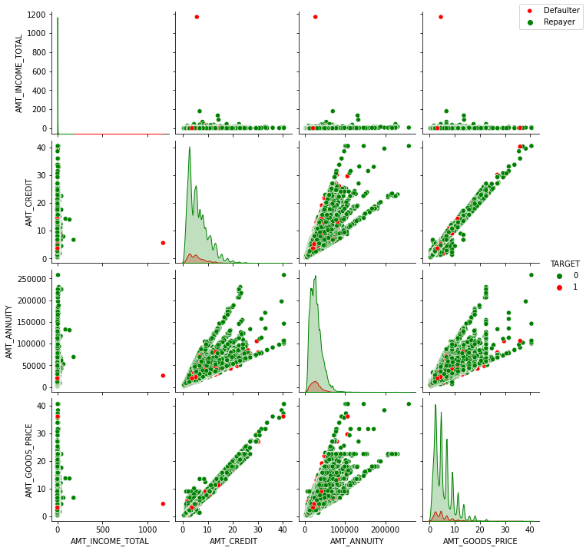
Bivariate Analysis on Numerical variables

Slide 14

Following the analysis of the datasets, there are a few characteristics of a client that the bank can use to determine whether or not they will repay the loan. The analysis consists of contributing factors and categorization.

Slide 15
Factor that determines whether an applicant will Repayer the loan
REGION RATING CLIENT: RATING 1 is more secure.
ORGANIZATION TYPE: Less than 3% of clients with Trade Types 4 and 5 and Industry Type 8 have defaulted.
DAYS BIRTH: People over the age of 50 have a low likelihood of defaulting.
DAYS EMPLOYED: Clients with 40+ years of experience have a default rate of less than 1%.
NAME INCOME TYPE: There are no defaults for students or business owners.
AMT INCOME TOTAL: Applicant with a total income of more than $700,000 is less likely to default.
NAME CASH LOAN PURPOSE: Loans obtained for hobby purposes, such as purchasing a garage, are mostly repaid.
CNT CHILDREN: People with 0 to 2 children are more likely to repay their loans. There are fewer defaults for NAME EDUCATION TYPE: Academic degree.

Slide 16
The following factors will determine whether an applicant will be a defaulter:
CODE GENDER: Men have a higher default rate than women.
NAME FAMILY STATUS: People who are civilly married or single tend to default a lot.
NAME EDUCATION TYPE: People who have completed their Lower Secondary and Secondary education.
NAME INCOME TYPE: Clients on Maternity Leave OR Unemployed frequently default.
REGION RATING CLIENT: People in Rating 3 have the highest defaults.
OCCUPATION TYPE: Avoid low-skilled labourers, drivers, waiters/bartenders, security personnel, labourers, and cooks because their default rate is extremely high.
ORGANIZATION TYPE: Transport: type 3 (16%), Industry: type 13 (13.5%), Industry: type 8 (12.5%), and Restaurant: type 3 (16%) are the organisations with the highest percentage of loans not repaid (less than 12 percent ). Self-employed people have a high default rate and should be avoided when applying for a loan or providing a loan with a higher interest rate to reduce the risk of default.
DAYS BIRTH: Avoid young people between the ages of 20 and 40 because they are more likely to default.
DAYS EMPLOYED: People with less than five years of experience have a high default rate.
CNT CHILDREN AND CNT FAMILY MEMBERS: Clients with a total of 9 or more children Their applications will be rejected because they have made a complete default.
AMT GOODS PRICE: When the credit amount exceeds 3 lakhs, the number of defaulters increases.

Slide 17

90% of the previously cancelled clients have actually repaid the loan. Record the reason for cancellation so that the bank can determine and negotiate terms with these repaying customers in the future to increase business opportunities.
88 % of clients who were previously denied a loan by a bank are now repaying clients. As a result, documenting the reason for rejection could help to mitigate the business loss, and these clients could be contacted for additional loans.

Slide 18


